Slide 1
Graduate Artificial Intelligence CS 640 Robot Path Planning
Jeffrey Considine
jconsidi@bu.edu

Slide 2
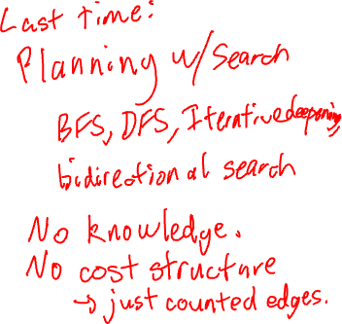
Plan for Today
Search with Costs
Search with Knowledge
Robot path planning
Complexities of real-valued spaces
More complex robots (extra)

Slide 3
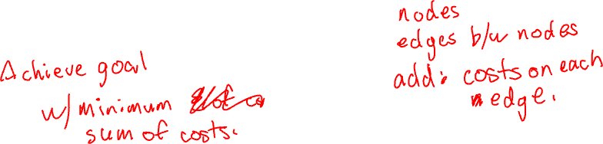
Search with Costs
So far, just searched for any path from start state to a goal state.
What if some edges (actions) are more expensive?
Shorter/cheaper paths may be preferable.

Slide 4
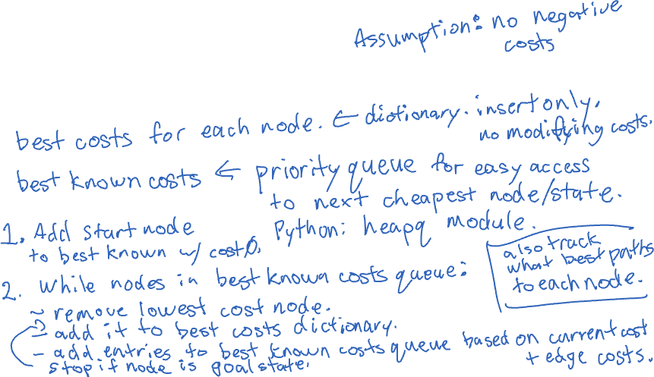
Dijkstra’s Algorithm
Common single source shortest path algorithm…

Slide 5
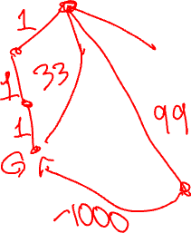
Dijkstra’s Algorithm as Uniform Cost Search
Dijkstra’s algorithm finishes vertices in increasing order of cost.

Slide 6
Unit Costs and Breadth-First Search
If all edge costs are the same, then BFS give also gives us minimum cost paths.

Slide 7
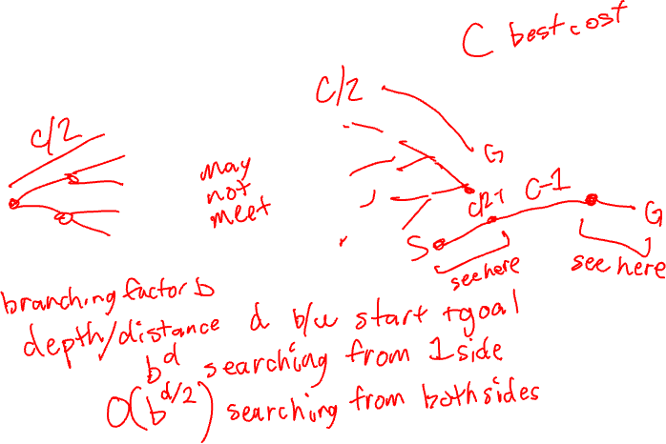
Bidirectional Search with Costs
Does this work?

Slide 8
Any Questions?

Slide 9
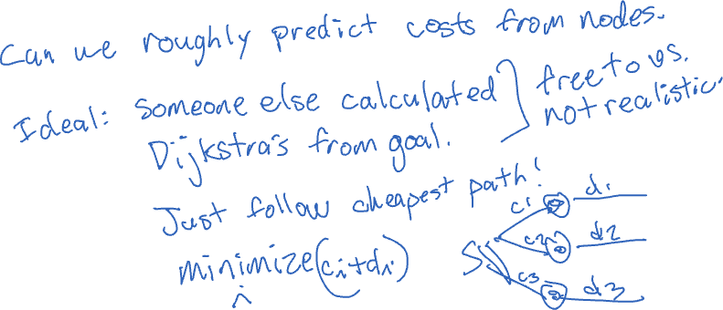
Informed Search
How can we do better than brute force searching all nodes?

Slide 10
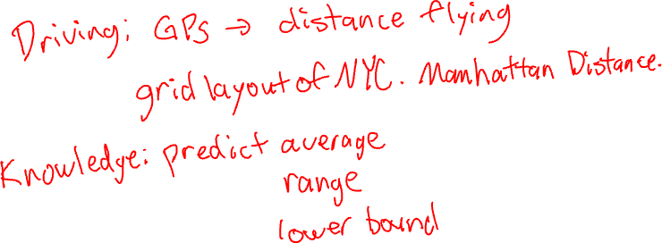
Domain Knowledge
If we know about our problem, can we use that for a performance edge?

Slide 11
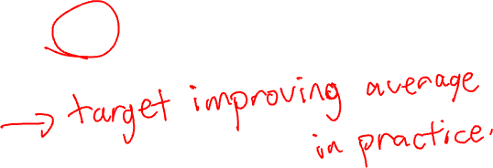
Heuristic Functions
A heuristic is a best guess about which nodes are better or worse.
No guarantees!

Slide 12
Best-First Search
Generic best-first search: Prioritize search with a plug-in function to order nodes.
Breadth first search: best-first ordered by increasing discovery order.
Depth first search: best-first ordered by decreasing discovery order.
Generic implementation uses a priority queue…

Slide 13
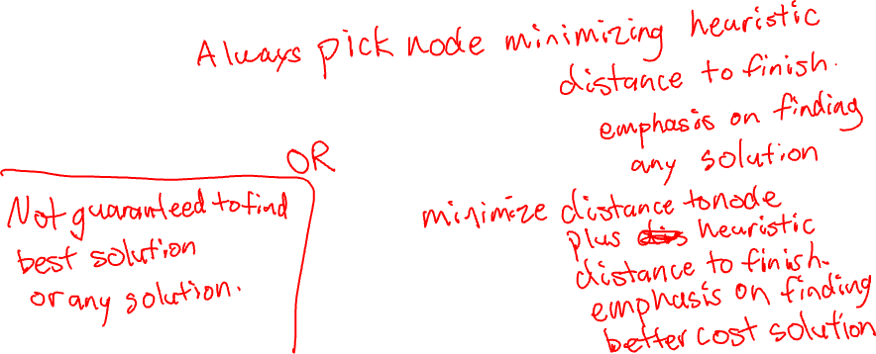
Greedy Best-First Search
Best-first search using a heuristic to order nodes.

Slide 14
Any Questions?

Slide 15
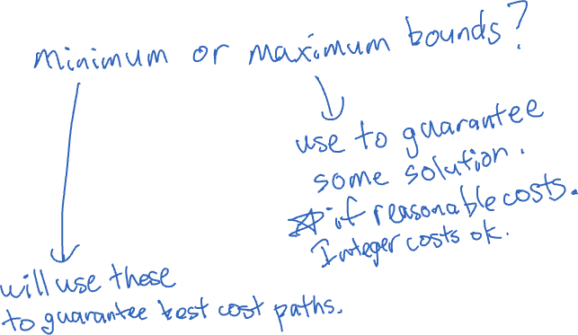
What if our heuristics are better than a guess?
Can we start making guarantees?

Slide 16
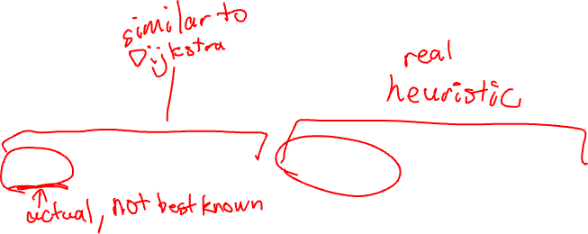
A* Algorithm
Best first search where heuristic = (best distance to node) + (estimated distance to goal)
What can we do with this?

Slide 17
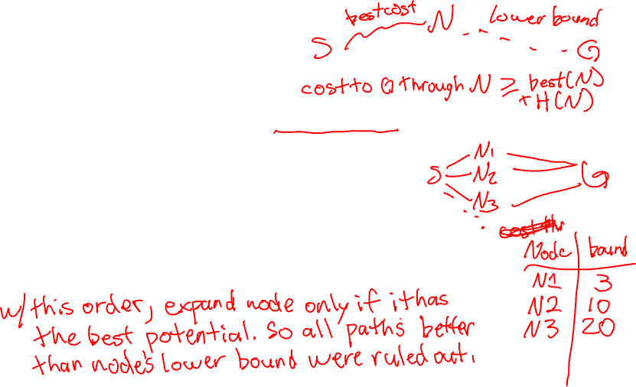
Admissible Heuristics
An admissible heuristic returns a lower bound on the remaining cost from a node to a goal state.
How does this work with A*? heuristic = (best distance to node) + (lower bound to goal)

Slide 18
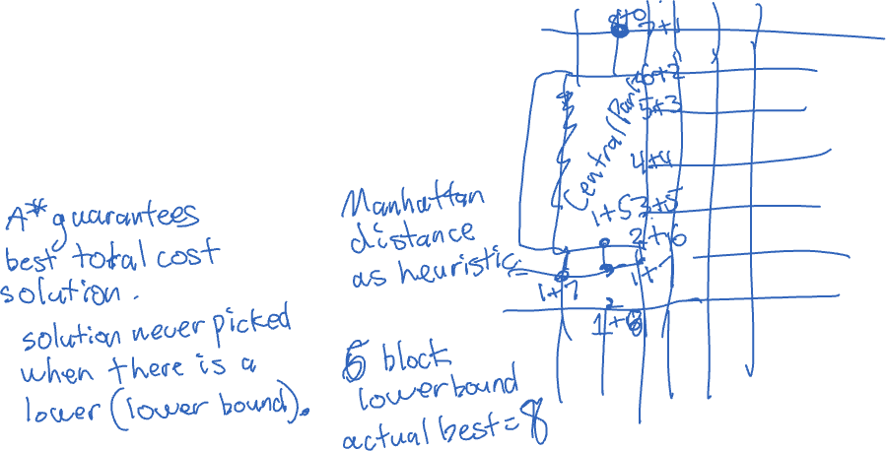
Optimality of A*
What can we guarantee with A*?

Slide 19
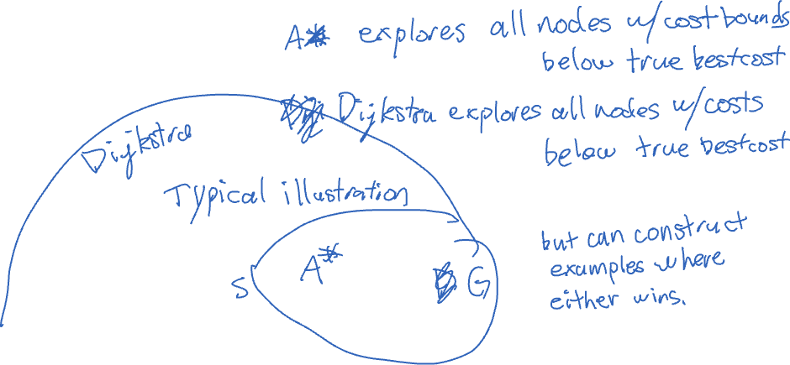
A* vs Dijkstra’s Algorithm
???

Slide 20
Satisficing Search
What if heuristic is not admissible, but close?

Slide 21
Any Questions?

Slide 22
Memory-Bounded Search
Previous challenge: too many nodes for memory.
Previous answer: iterative deepening.
Can we handle cost-bounded searches with memory bounds?

Slide 23
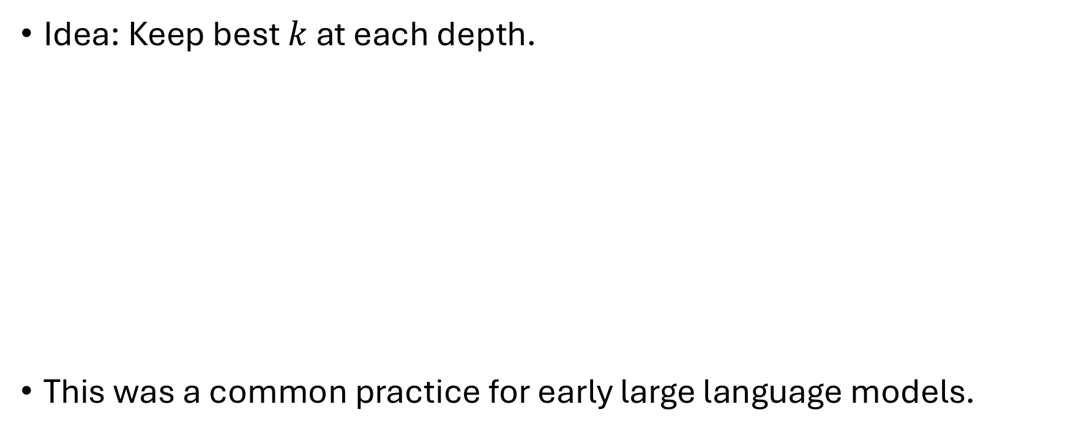
Beam Search
Idea: Keep best $k$ at each depth.
This was a common practice for early large language models.

Slide 24
Iterative-Deepening A* (IDA*)
Idea: iterative deepening, but use increasing cost bounds instead of depth bounds.

Slide 25
Any Questions?

Slide 26
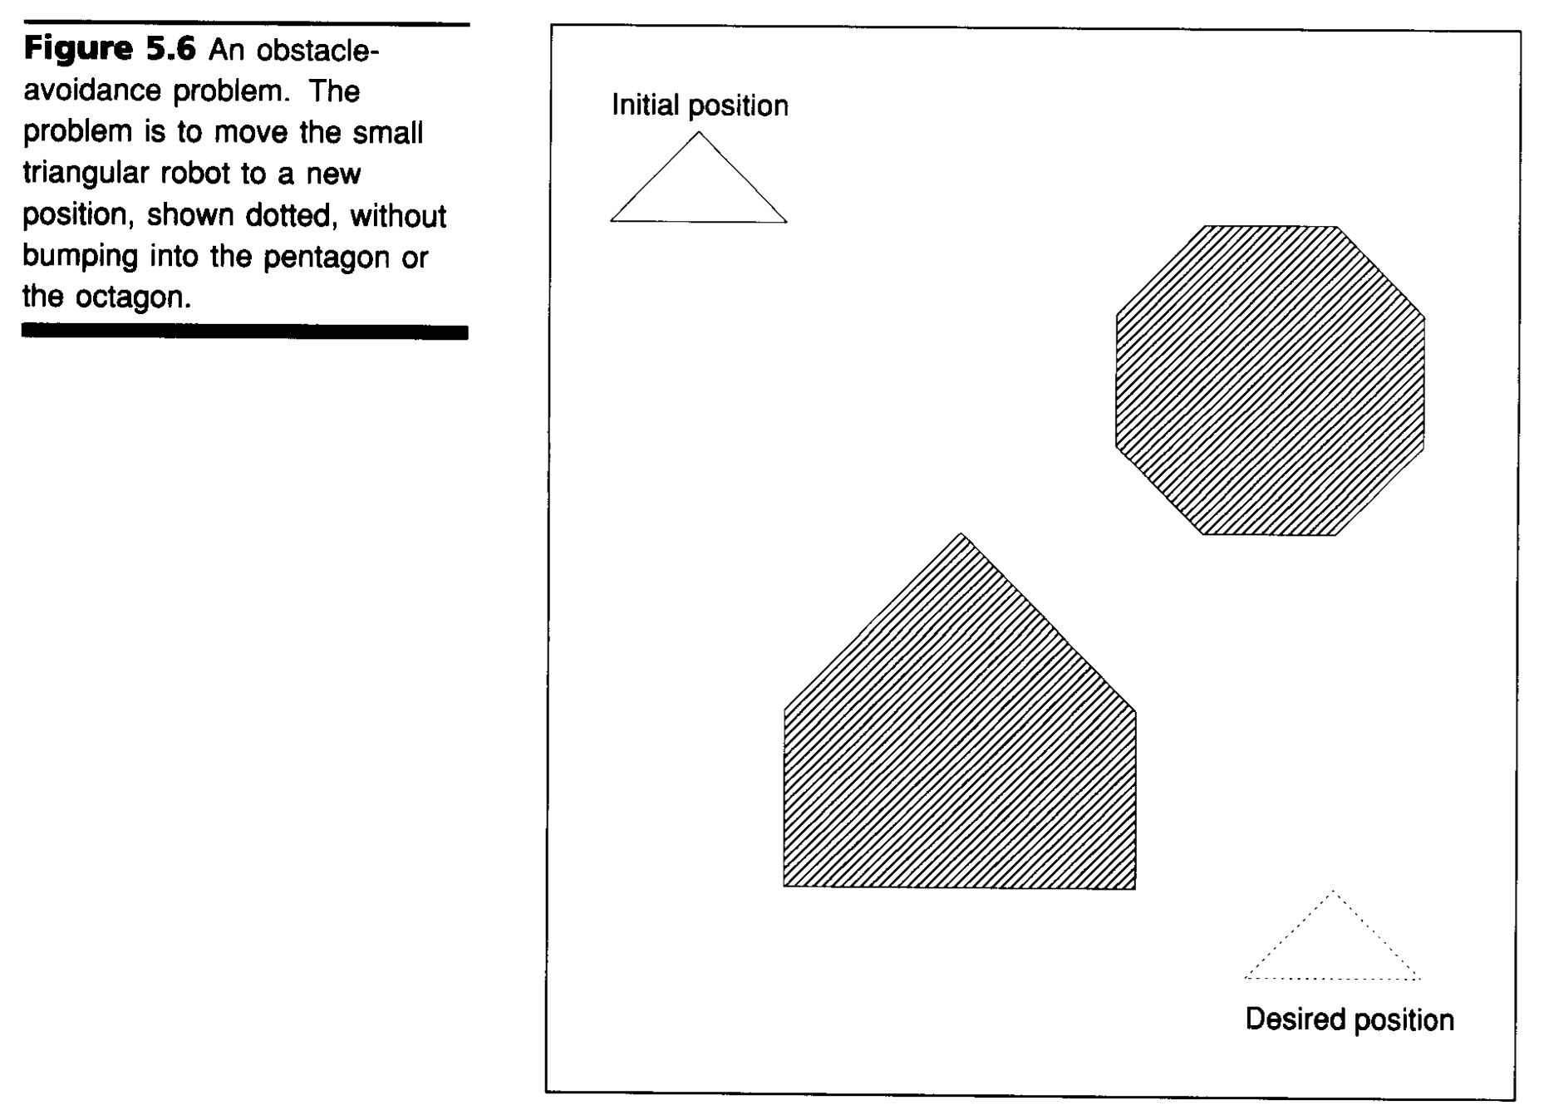
Robot Path Planning
Image source: Winston, chapter 5, https://courses.csail.mit.edu/6.034f/ai3/ch5.pdf

Slide 27
Reducing Robot Path Planning to Search
Image source: Winston, chapter 5, https://courses.csail.mit.edu/6.034f/ai3/ch5.pdf

Slide 28

What are the States?
???

Slide 29
What are the Valid States?
Image source: Winston, chapter 5, https://courses.csail.mit.edu/6.034f/ai3/ch5.pdf

Slide 30
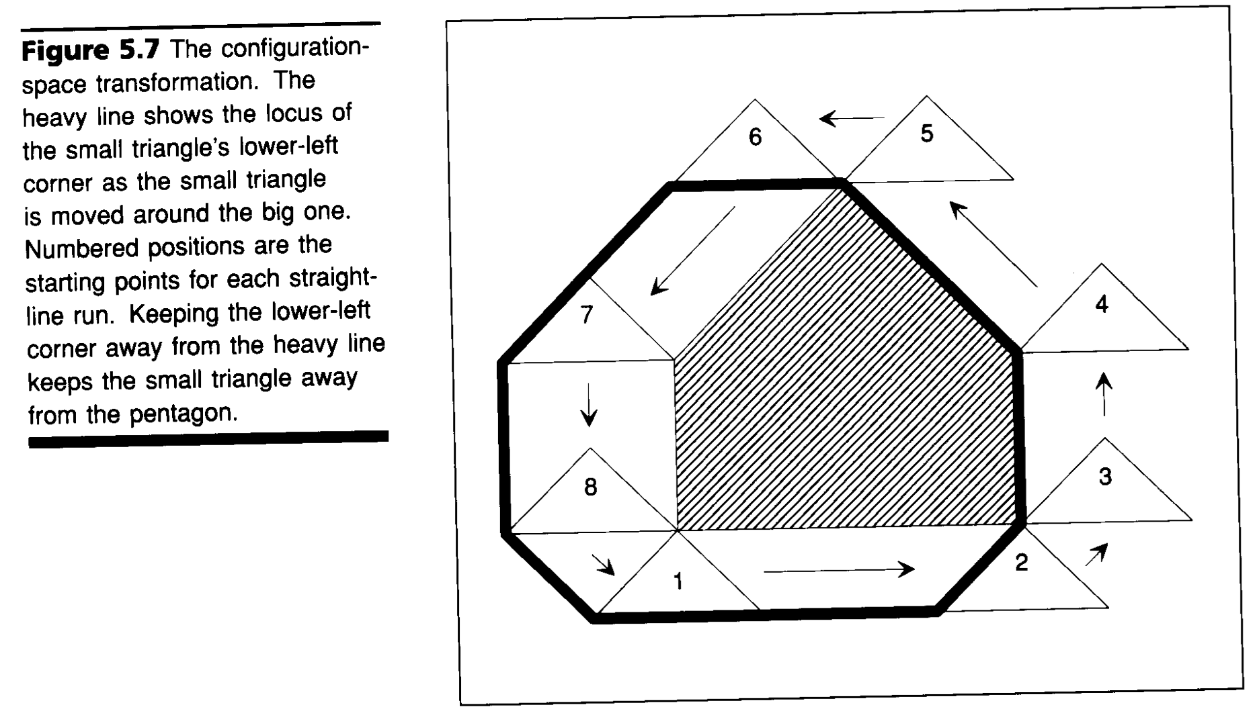

Mapping Invalid States
Image source: Winston, chapter 5, https://courses.csail.mit.edu/6.034f/ai3/ch5.pdf

Slide 31
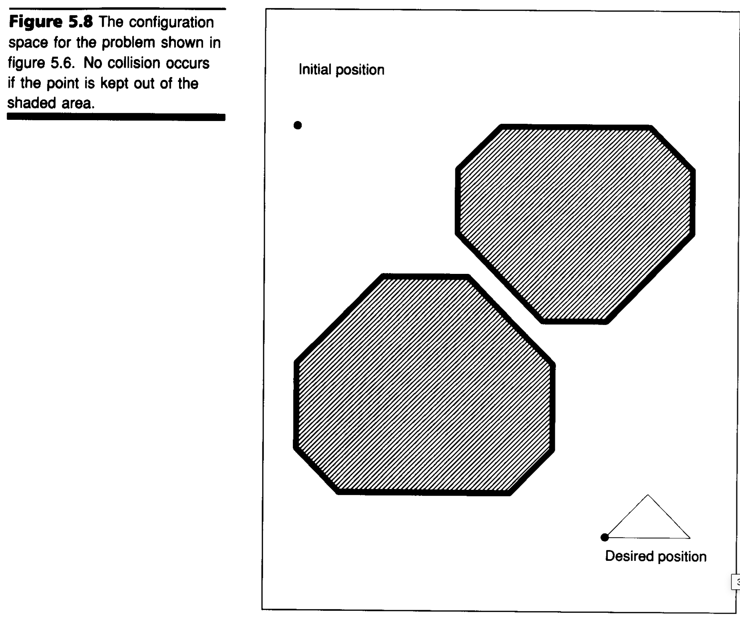
Valid States (not shaded)
Image source: Winston, chapter 5, https://courses.csail.mit.edu/6.034f/ai3/ch5.pdf

Slide 32
Is Every Valid Position Worth Considering?
Image source: Winston, chapter 5, https://courses.csail.mit.edu/6.034f/ai3/ch5.pdf

Slide 33
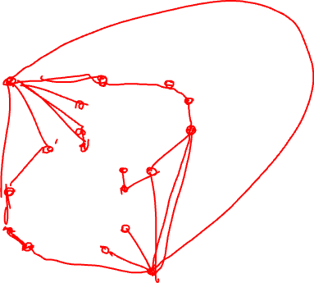
Which Positions Should We Consider?
Image source: Winston, chapter 5, https://courses.csail.mit.edu/6.034f/ai3/ch5.pdf

Slide 34
Which Transitions Should We Consider?
Image source: Winston, chapter 5, https://courses.csail.mit.edu/6.034f/ai3/ch5.pdf

Slide 35
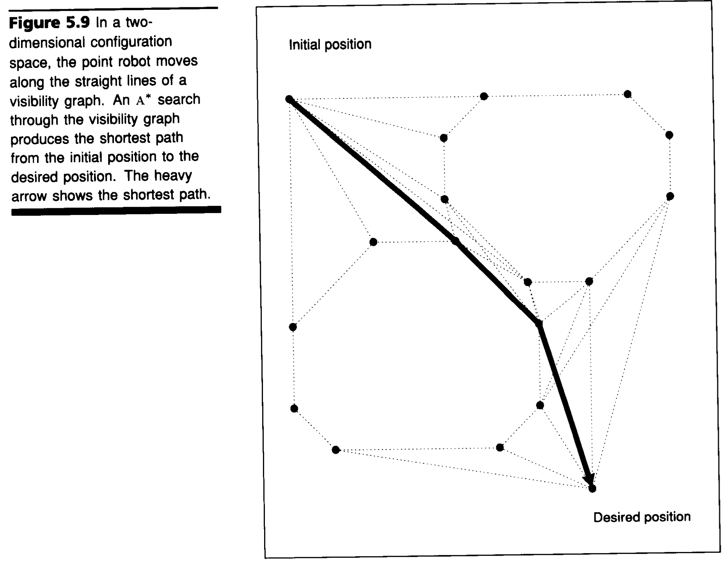
The Resulting Graph
Image source: Winston, chapter 5, https://courses.csail.mit.edu/6.034f/ai3/ch5.pdf

Slide 36
What Admissible Heuristic Should We Use?
Image source: Winston, chapter 5, https://courses.csail.mit.edu/6.034f/ai3/ch5.pdf

Slide 37
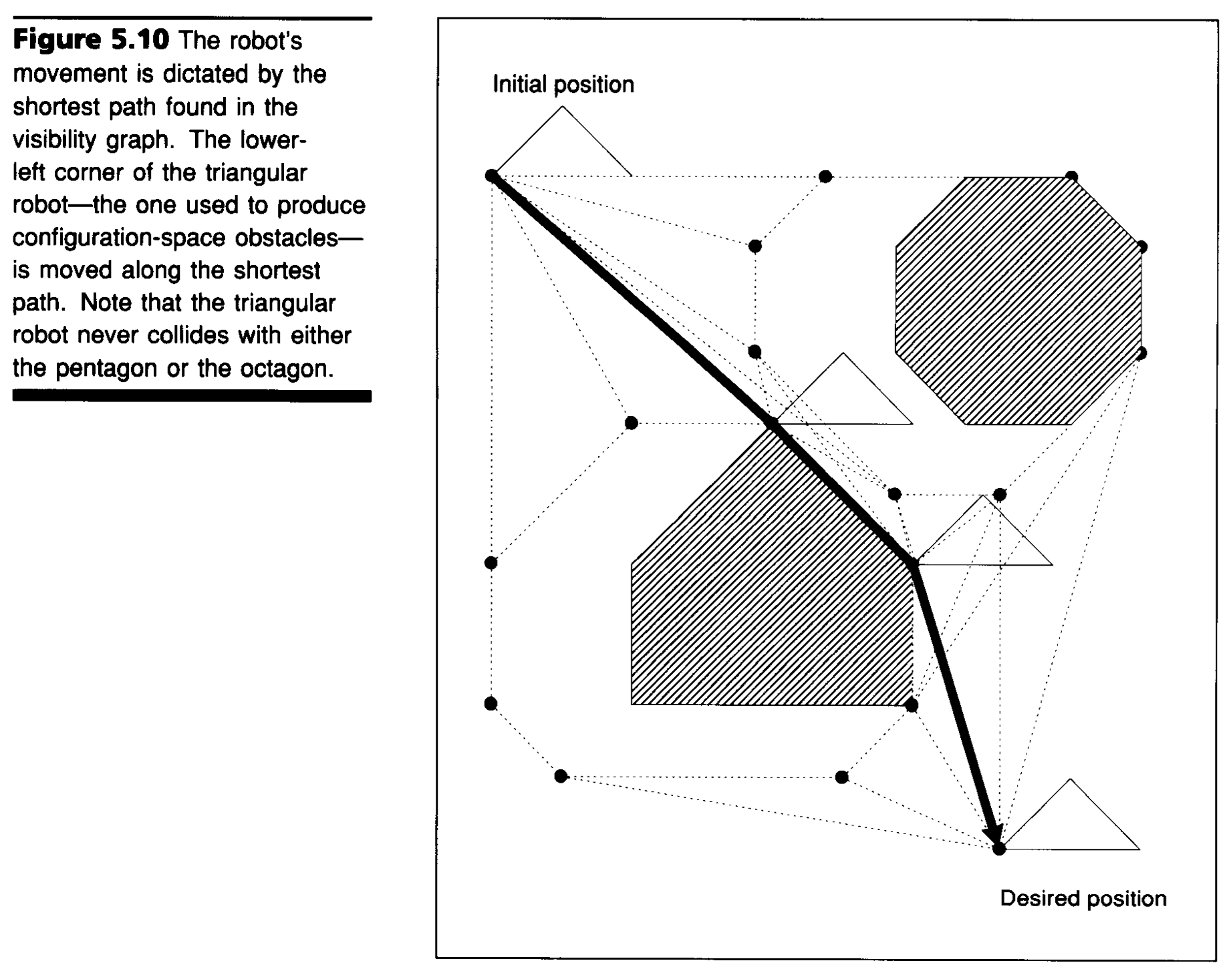
Success!
Image source: Winston, chapter 5, https://courses.csail.mit.edu/6.034f/ai3/ch5.pdf

Slide 38
What Would Change if Our Robot Can Rotate?
???

Slide 39
Any Questions?

Slide 40
Complexities of Real-Valued Spaces
How many states in the space?
How many states are reachable?
How many states are useful?

Slide 41
How do We Discretize States?
???

Slide 42
Any Questions?

Slide 43
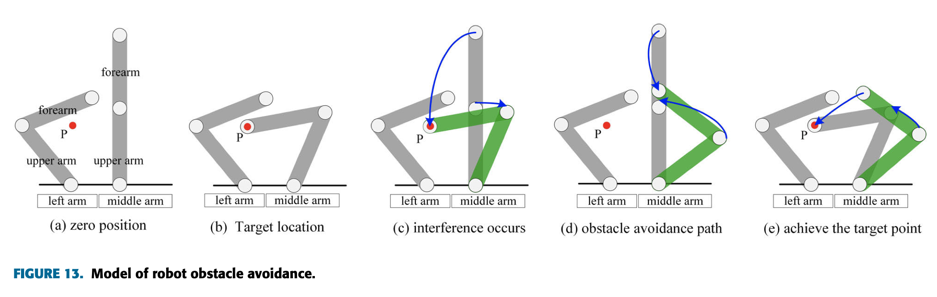
Robots can be More Complex!
Image source: Zhao et al, Research on Collision Avoidance Control of Multi-Arm Medical Robot Based on C-Space, 2020.

Slide 44
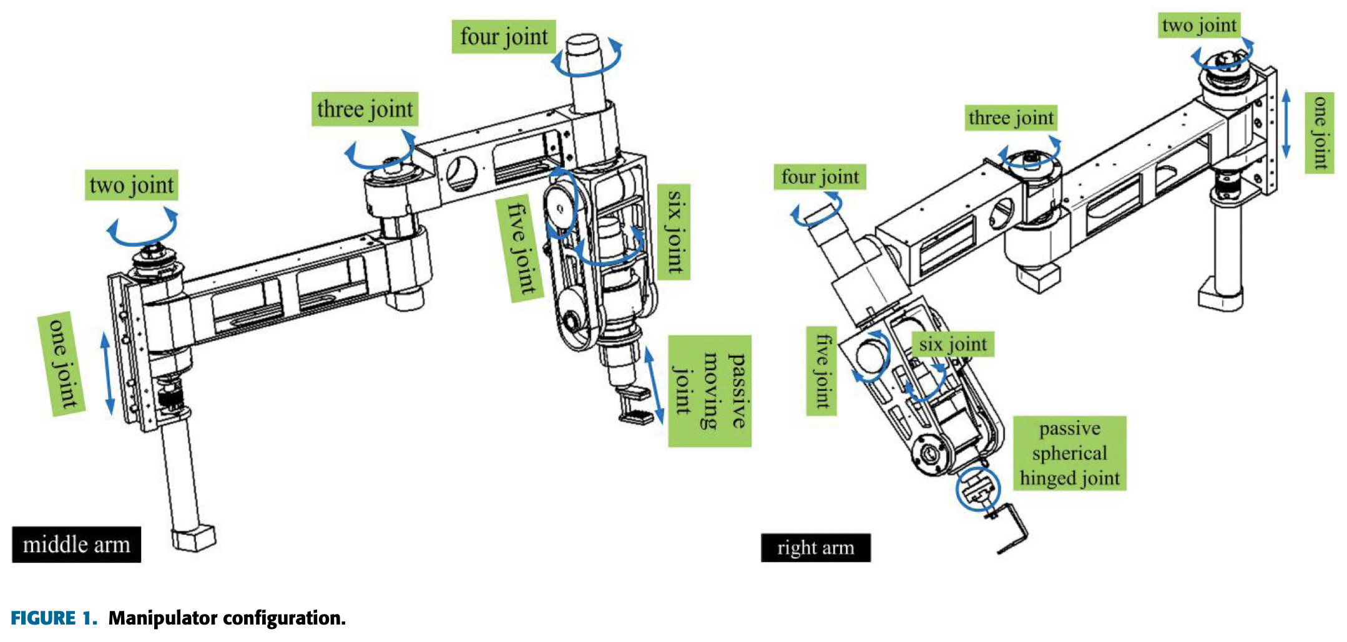
Robots can be Even More Complex!
Image source: Zhao et al, Research on Collision Avoidance Control of Multi-Arm Medical Robot Based on C-Space, 2020.

Slide 45
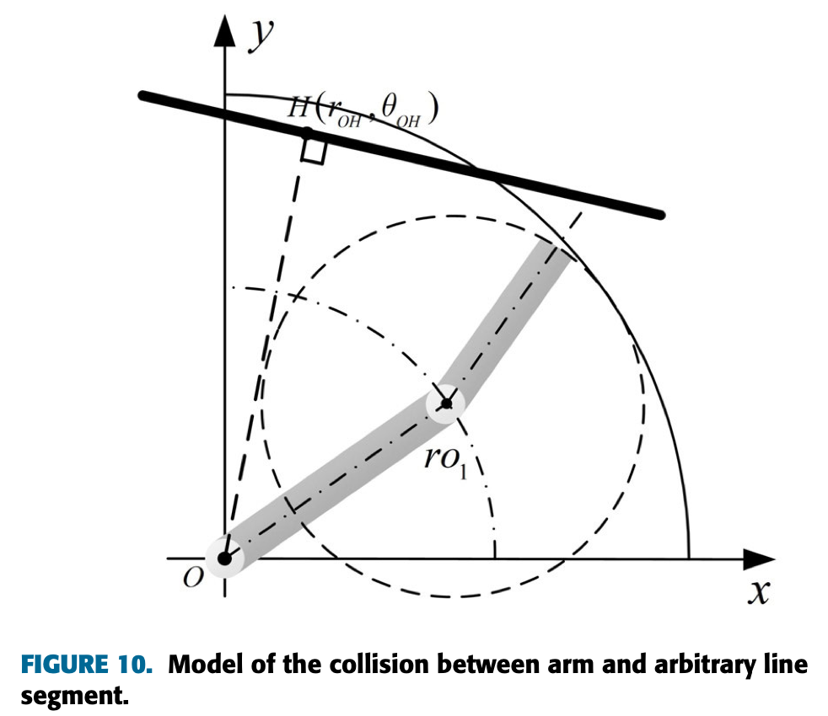
Modeling a Single Obstacle
Image source: Zhao et al, Research on Collision Avoidance Control of Multi-Arm Medical Robot Based on C-Space, 2020.

Slide 46
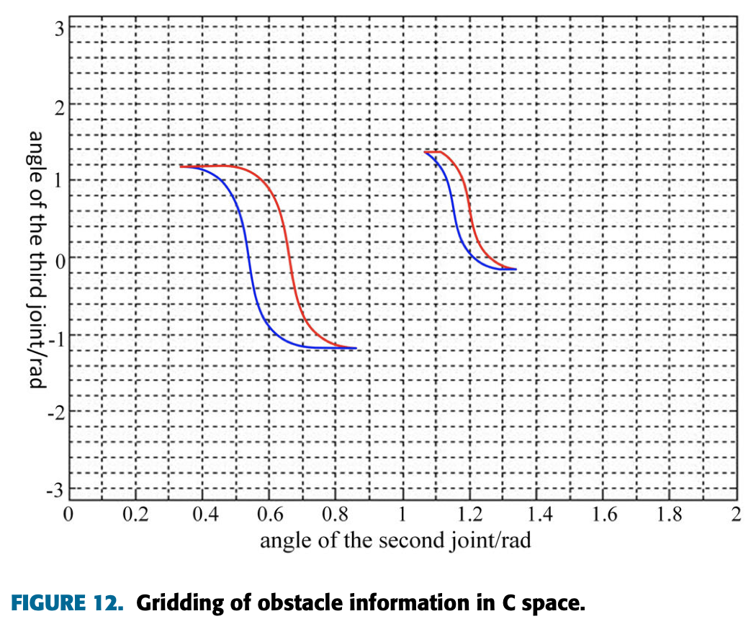
Mapping Obstacles
Image source: Zhao et al, Research on Collision Avoidance Control of Multi-Arm Medical Robot Based on C-Space, 2020.

Slide 47
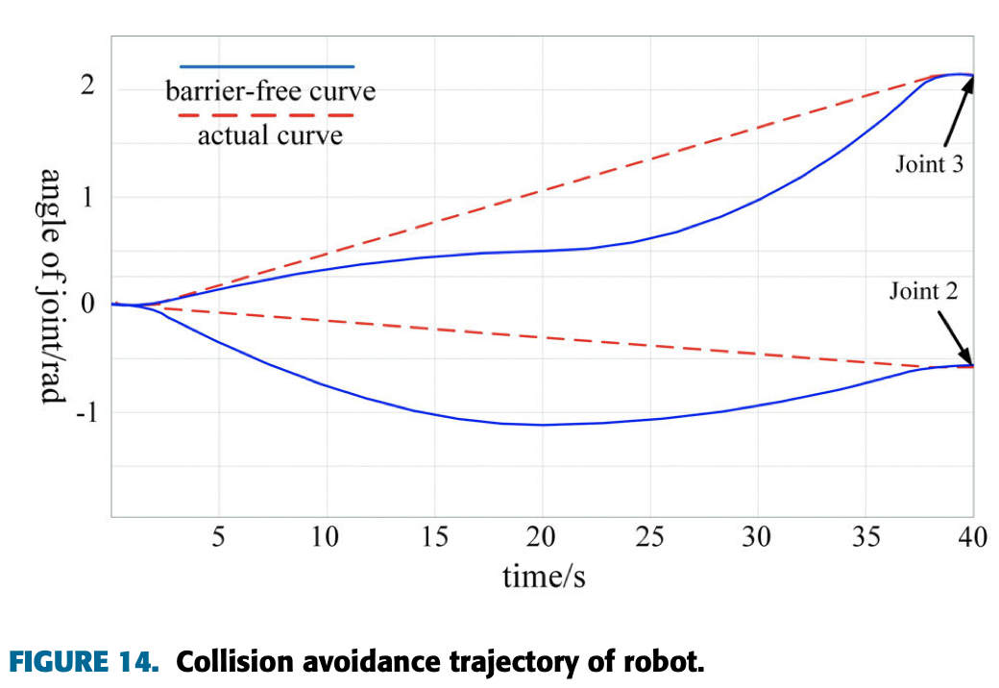
Routing Around Obstacles
Image source: Zhao et al, Research on Collision Avoidance Control of Multi-Arm Medical Robot Based on C-Space, 2020.

Slide 48
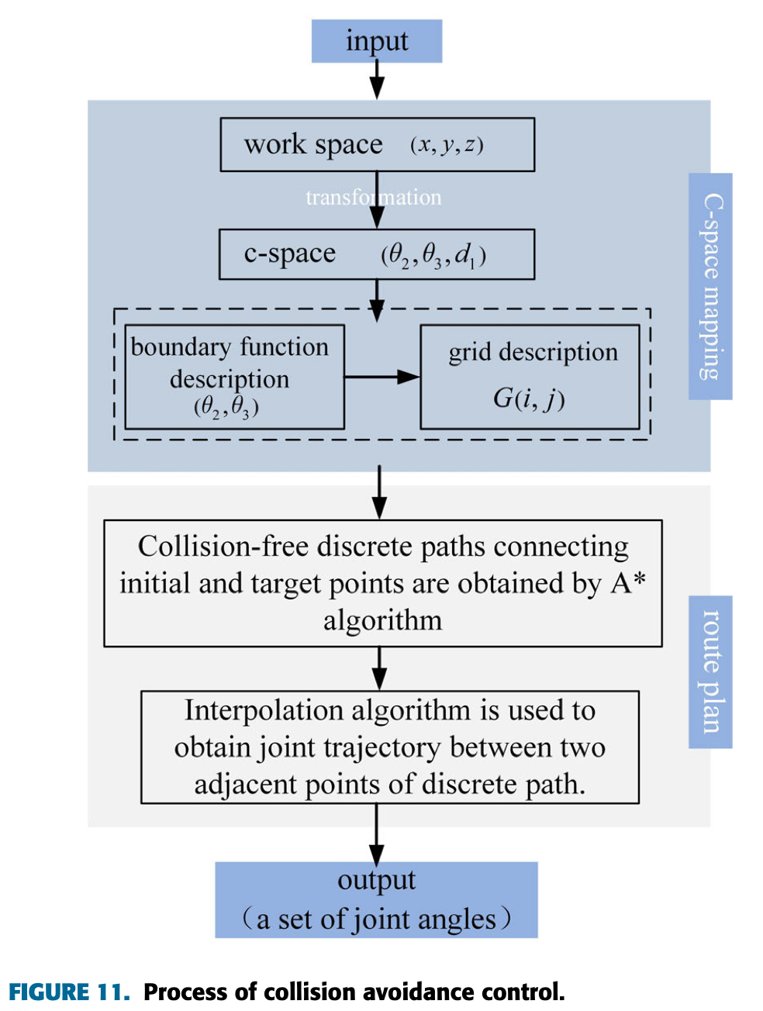
Building a System
Image source: Zhao et al, Research on Collision Avoidance Control of Multi-Arm Medical Robot Based on C-Space, 2020.

Slide 49
How Does This Scale to More Joints?
???

Slide 50
What About Multiple Moving Arms?
???

Slide 51
Any Questions?

